Slide 1

Workflow & Concepts
MODULE – 2

Slide 2
Idealized Data Science Project Workflow
Problem identification
Decide on Problem
Obtain data to solve your problems. Do not choose your problems based on the data you have.
Data acquisition
Acquire Data
Think about
text and
image data
Clean Data
Extract Features
Pre-processing
Deal With Missing Data
Select Features
Generate Models
Modeling
Process
Core duties of a data scientist
Select Final Model
Evalute Final Model
Application
Use Model

Slide 3
Supervised vs Unsupervised Learning
Supervised Learning
Aim: To predict target variable(s) based on input features
Data consists of input features (X variables) and target variable (Y variable).
Train/fit statistical models using data where target variable is known.
Unsupervised Learning
Aim: To find patterns or natural groupings in data
Data is not split into input and target variables (or: all variables are input features)
This course looks at supervised learning

Slide 4
Regression vs Classification
Regression
Target variable is real valued (numeric)
Concept: Regression curve
The estimated value of the target variable for different values of the input features
Classification
Target variable is categorical (discrete/nominal)
Concept: Decision boundary
The boundaries within the input space where the estimated value of the target variable changes
Specialist techniques exist for when the target variable is ordinal (ordered non-numeric). We will not look at these in this course.

Slide 5
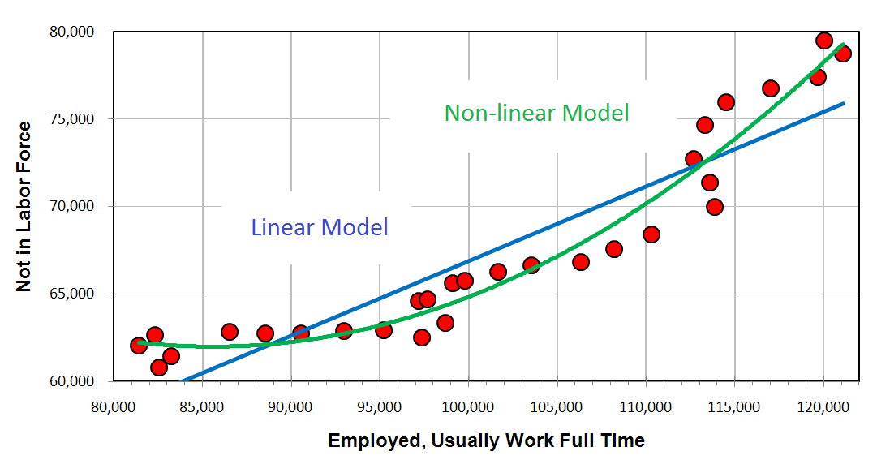
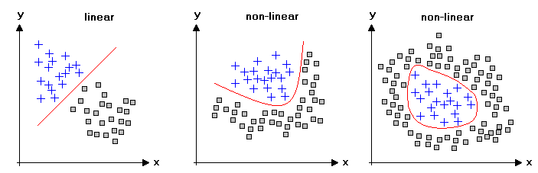
Linear vs Non-linear Models
Linear Models
Regression curve or decision boundary is linear
Weighted sum of real input features (plus intercept), conditional on discrete input features.
Point in 1d. Line in 2d. Plane in 3d. Hyperplane/affine space in general.
Non-linear Models
Regression curve or decision boundary is not linear

